Slide 1
SEGMENTING HAMMERSMITH AND FULHAM WARDS
Date: 6th of June 2021
Inna Ivanove

Slide 2
Content
Borough map
Venue map
Top 5 most common venues for each borough
Clustering boroughs using Kmeans
Summary

Slide 3
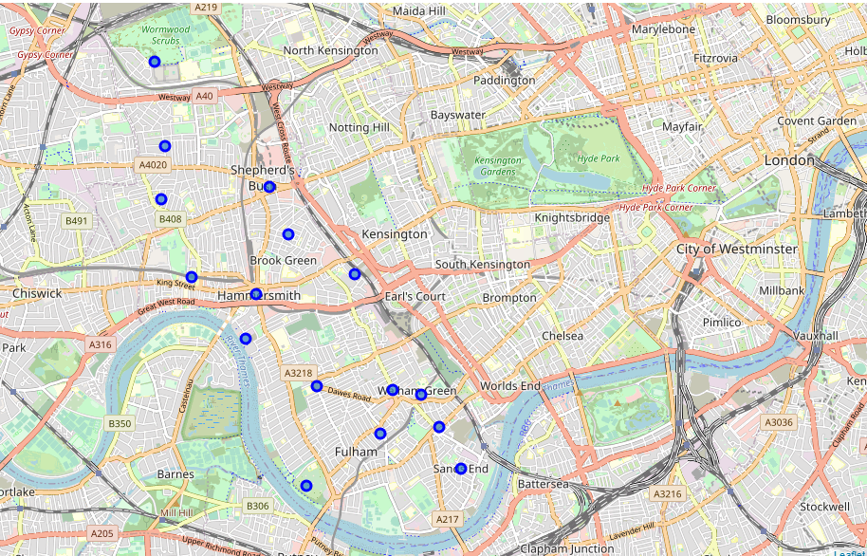
Borough map
In this project we will segment ward areas within one parliamentary constituency (Hammersmith and Fulham) in London using Foursquare data on venues in each of the ward. The results of the analysis will be several clusters of wards which have similar character in terms of the venues and facilities located in the wards and can be used by general public who lives in the constituency or planning to move in the area but not sure which of the wards they will prefer to live in.
The data on wards was taken from the UK government website. We have limited analysis to the one parliamentary constituency (Hammersmith and Fulham) as this area is quite familiar and it is easier to spot any inconsistencies or limitations in the analysis of the Foursquare data.

Slide 4
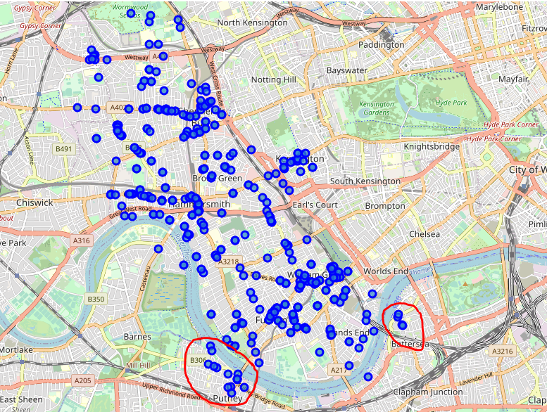
Venue map
Limitations of the Foursquare data:
Foursquare is using coordinates of each ward and radius to load data on venues. Coordinates of each ward is identified through OpenStreetMap. As the result it is almost impossible to catch all venues in the given ward as the shapes of them are different, some streets will be missing due to radius limitations and OpenStreetMap coordinates.
Foursquare data is not very reliable or objective. The highest number of venues are in the Food categories. Data doesn’t take into account a venue’s size; it can duplicate venues due to radius limitations described earlier in the analysis. Also, the data largely rely on categorization of the users, same type of venues can be classified as cafe or coffee shops. Venue locations are often not in the same area, like places located in Fulham are being ticked as Putney again due to radius.

Slide 5
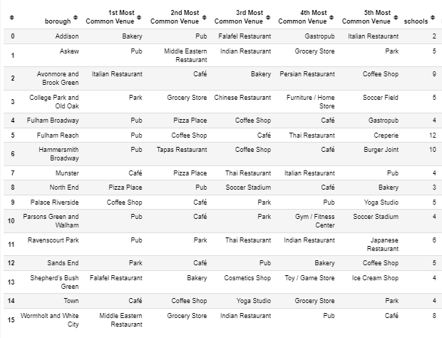
Top 5 most common venues for each borough

Slide 6
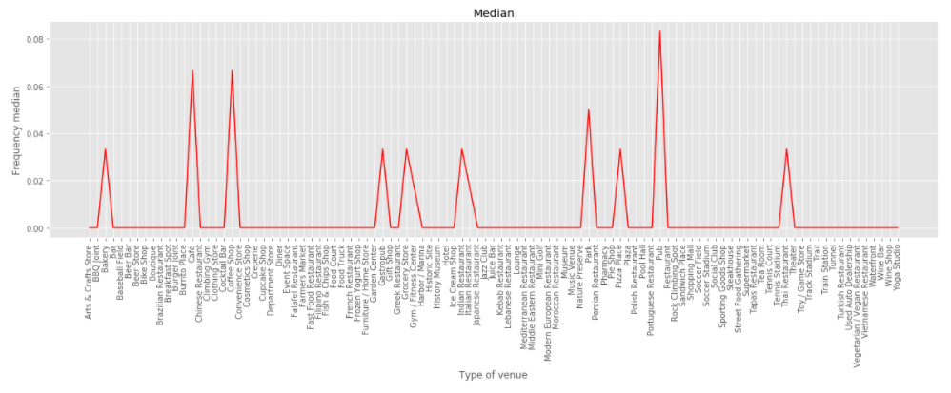
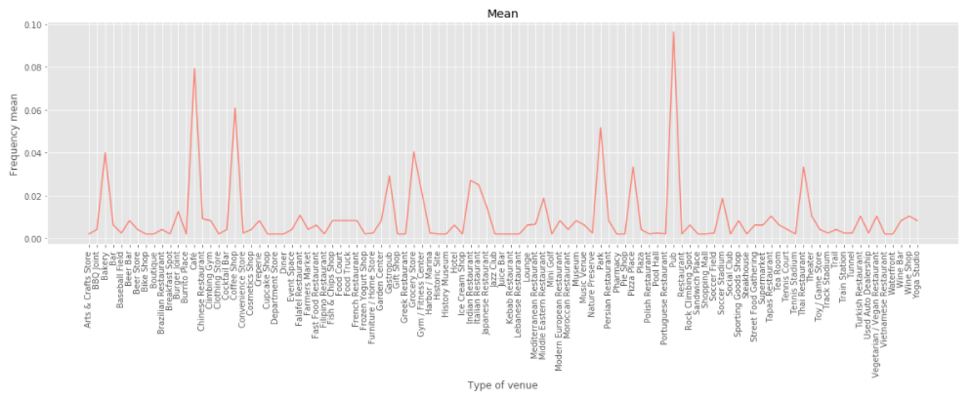
Top 5 most common venues for each borough
It can be noted that the most common venues are pub, cafe and coffee shop. They have the highest median and mean frequencies. Standard deviation for most venues is quite low, therefore the venues df can be considered as homogeneous.
Common venues where median is above zero are bakery, gastropub, grocery store, Indian restaurant, pizza place, Thai Restaurant and Parks.

Slide 7
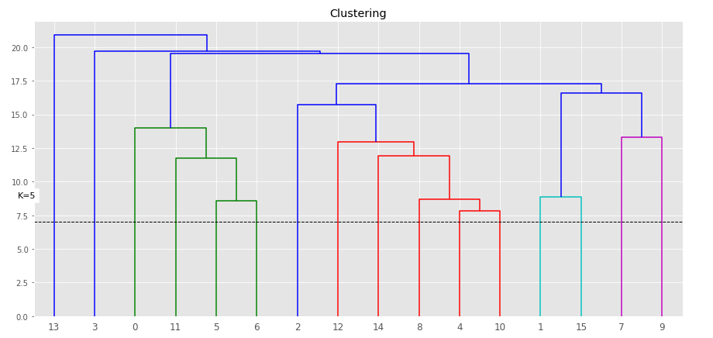
Clustering boroughs using KMeans
We can see how dendrogramm allocated each borough to group, identifying 5 different colours (groups).
However, silhouette score shows that the best number of clusters will be only two, where score is 0.221. For 5 clusters silhouette score is 0.094 and higher than for 3 or 4.
We have decided to use five clusters as for two clusters almost all wards were identified as the same cluster.

Slide 8
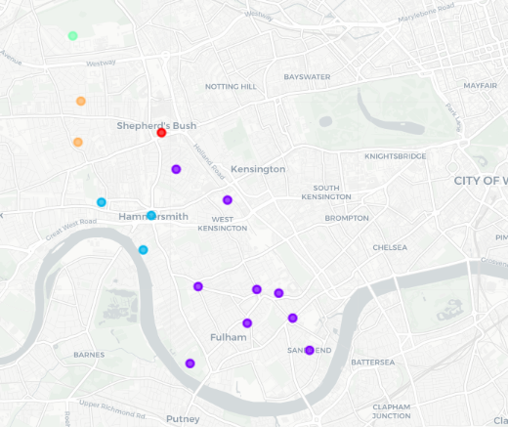
Clusters’ description
Most common venues for red cluster are pubs. Unlike purple cluster, other common venues are not only places to eat, but gyms, stadiums, yoga etc.
Purple cluster is the most scattered on the map. It has largest number of schools. Most common venues are mainly places to eat
Blue cluster include only one area - Shepherd's Bush. Comparing to other clusters it has three venues out of five which are not place to eat, also it does not have pubs / coffee shops / cafes / parks amongst the most common.
Only one area was allocated to the green cluster. Green cluster is quite different from others as the top5 most common venues include only one place to eat, rest are stores, parks, fields. And looking at the map this area is further away from others and has large green area.
Orange cluster includes areas with relatively large number of schools. Pubs are the most common venues around the area but quite low frequency of coffee shops and cafes comparing to red cluster, which is similar to orange cluster. For example, in Ravenscourt park 5 most common venues do not include coffee shops or cafes. And parks are common venues only in one ward, Ravenscourt park.

Slide 9
Summary
In this project we have analyzed foursquare data on venues and government data on number of schools for wards located in Hammersmith and Fulham council in London. Using KMeans algorithm we have segmented wards into five clusters.
Foursquare data isn’t all-encompassing. The highest number of venues are in the Food categories. Data doesn’t take into account a venue’s size, it can duplicate venues due to radius limitations described earlier in the analysis. Also the data largely rely on categorization of the users, same type of venues can be classified as cafe or coffee shops.
Analysis can be further improved by testing hypothesis if clusters are truly different, if there are statistically significant differences between them.
Foursquare data is limited but can provide some insights. I suggest it cannot be used alone but maybe as addition to other sources for the purposes of accuracy, completeness and reliability.

